Slide 1


Data-Intensive Distributed Computing
CS 451/651 (Fall 2018)
Part 1: MapReduce Algorithm Design (4/4)
September 18, 2018
Jimmy Lin
David R. Cheriton School of Computer Science
University of Waterloo
These slides are available at http://lintool.github.io/bigdata-2018f/
This work is licensed under a Creative Commons Attribution-Noncommercial-Share Alike 3.0 United States See http://creativecommons.org/licenses/by-nc-sa/3.0/us/ for details

Slide 2

Source: Wikipedia (The Scream)

Slide 3

Source: Wikipedia (Japanese rock garden)

Slide 4
Perfect X
What’s the point?
More details: Lee et al. The Unified Logging Infrastructure for Data Analytics at Twitter.
PVLDB, 5(12):1771-1780, 2012.

Slide 5
MapReduce Algorithm Design
How do you express everything in terms of m, r, c, p?
Toward “design patterns”

Slide 6

MapReduce
Source: Google

Slide 7
MapReduce
Programmer specifies four functions:
map (k₁, v₁) → List[(k₂, v₂)]
reduce (k₂, List[v₂]) → List[(k₃, v₃)]
All values with the same key are sent to the same reducer
partition (k', p) → 0 ... p-1
Often a simple hash of the key, e.g., hash(k') mod n
Divides up key space for parallel reduce operations
combine (k₂, List[v₂]) → List[(k₂, v₂)]
Mini-reducers that run in memory after the map phase
Used as an optimization to reduce network traffic
The execution framework handles everything else…

Slide 8
k₁
v₁
k₂
v₂
k₃
v₃
k₄
v₄
k₅
v₅
k₆
v₆
map
map
map
map
a
1
b
2
c
3
c
6
a
5
c
2
b
7
c
8
combine
combine
combine
combine
a
1
b
2
c
9
a
5
c
2
b
7
c
8
partition
partition
partition
partition
group values by key
a
1
5
b
2
7
c
2
9
8
*
*
*
reduce
reduce
reduce
r₁
s₁
r₂
s₂
r₃
s₃
* Important detail: reducers process keys in sorted order

Slide 9
“Everything Else”
Handles scheduling
Assigns workers to map and reduce tasks
Handles “data distribution”
Moves processes to data
Handles synchronization
Gathers, sorts, and shuffles intermediate data
Handles errors and faults
Detects worker failures and restarts

Slide 10
But…
You have limited control over data and execution flow!
All algorithms must be expressed in m, r, c, p
You don’t know:
Where mappers and reducers run
When a mapper or reducer begins or finishes
Which input a particular mapper is processing
Which intermediate key a particular reducer is processing

Slide 11
Tools for Synchronization
Preserving state in mappers and reducers
Capture dependencies across multiple keys and values
Cleverly-constructed data structures
Bring partial results together
Define custom sort order of intermediate keys
Control order in which reducers process keys

Slide 12
Two Practical Tips
Avoid object creation
(Relatively) costly operation
Garbage collection
Avoid buffering
Limited heap size
Works for small datasets, but won’t scale!

Slide 13
Importance of Local Aggregation
Ideal scaling characteristics:
Twice the data, twice the running time
Twice the resources, half the running time
Why can’t we achieve this?
Synchronization requires communication
Communication kills performance
Thus… avoid communication!
Reduce intermediate data via local aggregation
Combiners can help

Slide 14
Distributed Group By in MapReduce
Mapper
intermediate files (on disk)
merged spills (on disk)
Combiner
Reducer
circular buffer (in memory)
Combiner
other reducers
spills (on disk)
other mappers

Slide 15
Word Count: Baseline
class Mapper {
def map(key: Long, value: String) = {
for (word <- tokenize(value)) {
emit(word, 1)
}
}
}
class Reducer {
def reduce(key: String, values: Iterable[Int]) = {
for (value <- values) {
sum += value
}
emit(key, sum)
}
}
What’s the impact of combiners?

Slide 16
Word Count: Mapper Histogram
class Mapper {
def map(key: Long, value: String) = {
val counts = new Map()
for (word <- tokenize(value)) {
counts(word) += 1
}
for ((k, v) <- counts) {
emit(k, v)
}
}
}
Are combiners still needed?

Slide 17
Performance
Word count on 10% sample of Wikipedia
Running Time
# Pairs
Baseline
~140s
246m
Histogram
~140s
203m

Slide 18
Can we do even better?

Slide 19
k₁
v₁
k₂
v₂
k₃
v₃
k₄
v₄
k₅
v₅
k₆
v₆
map
map
map
map
a
1
b
2
c
3
c
6
a
5
c
2
b
7
c
8
combine
combine
combine
combine
a
1
b
2
c
9
a
5
c
2
b
7
c
8
partition
partition
partition
partition
group values by key
a
1
5
b
2
7
c
2
9
8
*
*
*
Logical view
reduce
reduce
reduce
r₁
s₁
r₂
s₂
r₃
s₃
* Important detail: reducers process keys in sorted order

Slide 20
MapReduce API*
Mapper<K_{in},V_{in},K_{out},V_{out}>
void setup(Mapper.Context context)
Called once at the start of the task
void map(K_{in} key, V_{in} value, Mapper.Context context)
Called once for each key/value pair in the input split
void cleanup(Mapper.Context context)
Called once at the end of the task
Reducer<K_{in},V_{in},K_{out},V_{out}>/Combiner<K_{in},V_{in},K_{out},V_{out}>
void setup(Reducer.Context context)
Called once at the start of the task
void reduce(K_{in} key, Iterable<V_{in}> values, Reducer.Context context)
Called once for each key
void cleanup(Reducer.Context context)
Called once at the end of the task
*Note that there are two versions of the API!

Slide 21
Preserving State
Mapper object
Reducer object
one object per task
state
state
setup
API initialization hook
setup
map
one call per input key-value pair
reduce
one call per intermediate key
cleanup
API cleanup hook
cleanup

Slide 22
Pseudo-Code
class Mapper {
def setup() = {
...
}
def map(key: Long, value: String) = {
...
}
def cleanup() = {
...
}
}

Slide 23
Word Count: Preserving State
class Mapper {
val counts = new Map()
def map(key: Long, value: String) = {
for (word <- tokenize(value)) {
counts(word) += 1
}
}
def cleanup() = {
for ((k, v) <- counts) {
emit(k, v)
}
}
}
Key idea: preserve state across input key-value pairs!
Are combiners still needed?

Slide 24
Design Pattern for Local Aggregation
“In-mapper combining”
Fold the functionality of the combiner into the mapper
by preserving state across multiple map calls
Advantages
Speed
Why is this faster than actual combiners?
Disadvantages
Explicit memory management required
Potential for order-dependent bugs

Slide 25
Performance
Word count on 10% sample of Wikipedia
Running Time
# Pairs
Baseline
~140s
246m
Histogram
~140s
203m
IMC
~80s
5.5m

Slide 26
Combiner Design
Combiners and reducers share same method signature
Sometimes, reducers can serve as combiners
Often, not…
Remember: combiner are optional optimizations
Should not affect algorithm correctness
May be run 0, 1, or multiple times
Example: find average of integers associated with the same key

Slide 27
Computing the Mean: Version 1
class Mapper {
def map(key: String, value: Int) = {
emit(key, value)
}
}
class Reducer {
def reduce(key: String, values: Iterable[Int]) {
for (value <- values) {
sum += value
cnt += 1
}
emit(key, sum/cnt)
}
}
Why can’t we use reducer as combiner?

Slide 28
Computing the Mean: Version 2
class Mapper {
def map(key: String, value: Int) =
context.write(key, value)
}
class Combiner {
def reduce(key: String, values: Iterable[Int]) = {
for (value <- values) {
sum += value
cnt += 1
}
emit(key, (sum, cnt))
}
}
class Reducer {
def reduce(key: String, values: Iterable[Pair]) = {
for ((s, c) <- values) {
sum += s
cnt += c
}
emit(key, sum/cnt)
}
}
Why doesn’t this work?

Slide 29
Computing the Mean: Version 3
class Mapper {
def map(key: String, value: Int) =
context.write(key, (value, 1))
}
class Combiner {
def reduce(key: String, values: Iterable[Pair]) = {
for ((s, c) <- values) {
sum += s
cnt += c
}
emit(key, (sum, cnt))
}
}
class Reducer {
def reduce(key: String, values: Iterable[Pair]) = {
for ((s, c) <- values) {
sum += s
cnt += c
}
emit(key, sum/cnt)
}
}
Fixed?

Slide 30
Computing the Mean: Version 4
class Mapper {
val sums = new Map()
val counts = new Map()
def map(key: String, value: Int) = {
sums(key) += value
counts(key) += 1
}
def cleanup() = {
for (key <- counts.keys) {
context.write(key, (sums(key), counts(key)))
}
}
}
Are combiners still needed?

Slide 31
Performance
200m integers across three char keys
Java
Scala
~120s
V1
~120s
~90s
V3
~120s
~60s
V4
~90s
(default HashMap)
~70s
(optimized HashMap)

Slide 32
MapReduce API*
Mapper<K_{in},V_{in},K_{out},V_{out}>
void setup(Mapper.Context context)
Called once at the start of the task
void map(K_{in} key, V_{in} value, Mapper.Context context)
Called once for each key/value pair in the input split
void cleanup(Mapper.Context context)
Called once at the end of the task
Reducer<K_{in},V_{in},K_{out},V_{out}>/Combiner<K_{in},V_{in},K_{out},V_{out}>
void setup(Reducer.Context context)
Called once at the start of the task
void reduce(K_{in} key, Iterable<V_{in}> values, Reducer.Context context)
Called once for each key
void cleanup(Reducer.Context context)
Called once at the end of the task
*Note that there are two versions of the API!

Slide 33
Algorithm Design: Running Example
Term co-occurrence matrix for a text collection
M = N x N matrix (N = vocabulary size)
M_{ij}: number of times i and j co-occur in some context (for concreteness, let’s say context = sentence)
Why?
Distributional profiles as a way of measuring semantic distance
Semantic distance useful for many language processing tasks
Applications in lots of other domains

Slide 34
MapReduce: Large Counting Problems
Term co-occurrence matrix for a text collection = specific instance of a large counting problem
A large event space (number of terms)
A large number of observations (the collection itself)
Goal: keep track of interesting statistics about the events
Basic approach
Mappers generate partial counts
Reducers aggregate partial counts
How do we aggregate partial counts efficiently?

Slide 35
First Try: “Pairs”
Each mapper takes a sentence:
Generate all co-occurring term pairs
For all pairs, emit (a, b) → count
Reducers sum up counts associated with these pairs
Use combiners!

Slide 36
Pairs: Pseudo-Code
class Mapper {
def map(key: Long, value: String) = {
for (u <- tokenize(value)) {
for (v <- neighbors(u)) {
emit((u, v), 1)
}
}
}
}
class Reducer {
def reduce(key: Pair, values: Iterable[Int]) = {
for (value <- values) {
sum += value
}
emit(key, sum)
}
}

Slide 37
Pairs: Pseudo-Code
One more thing…
class Partitioner {
def getPartition(key: Pair, value: Int, numTasks: Int): Int = {
return key.left % numTasks
}
}

Slide 38
“Pairs” Analysis
Advantages
Easy to implement, easy to understand
Disadvantages
Lots of pairs to sort and shuffle around (upper bound?)
Not many opportunities for combiners to work

Slide 39
Another Try: “Stripes”
Idea: group together pairs into an associative array
(a, b) → 1
(a, c) → 2
(a, d) → 5
(a, e) → 3
(a, f) → 2
a → { b: 1, c: 2, d: 5, e: 3, f: 2 }
Each mapper takes a sentence:
Generate all co-occurring term pairs
For each term, emit a → { b: count_{b}, c: count_{c}, d: count_{d} … }
Reducers perform element-wise sum of associative arrays
a → { b: 1, d: 5, e: 3 }
a → { b: 1, c: 2, d: 2, f: 2 }
a → { b: 2, c: 2, d: 7, e: 3, f: 2 }
+
Key idea: cleverly-constructed data structure
brings together partial results

Slide 40
Stripes: Pseudo-Code
class Mapper {
def map(key: Long, value: String) = {
for (u <- tokenize(value)) {
val map = new Map()
for (v <- neighbors(u)) {
map(v) += 1
}
emit(u, map)
}
}
}
class Reducer {
def reduce(key: String, values: Iterable[Map]) = {
val map = new Map()
for (value <- values) {
map += value
}
emit(key, map)
}
}
a → { b: 1, c: 2, d: 5, e: 3, f: 2 }
a → { b: 1, d: 5, e: 3 }
a → { b: 1, c: 2, d: 2, f: 2 }
a → { b: 2, c: 2, d: 7, e: 3, f: 2 }
+

Slide 41
“Stripes” Analysis
Advantages
Far less sorting and shuffling of key-value pairs
Can make better use of combiners
Disadvantages
More difficult to implement
Underlying object more heavyweight
Overhead associated with data structure manipulations
Fundamental limitation in terms of size of event space

Slide 42
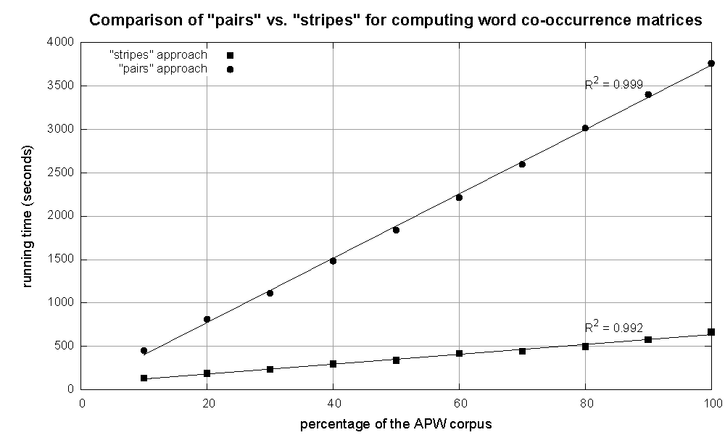
Cluster size: 38 cores
Data Source: Associated Press Worldstream (APW) of the English Gigaword Corpus (v3), which contains 2.27 million documents (1.8 GB compressed, 5.7 GB uncompressed)

Slide 43
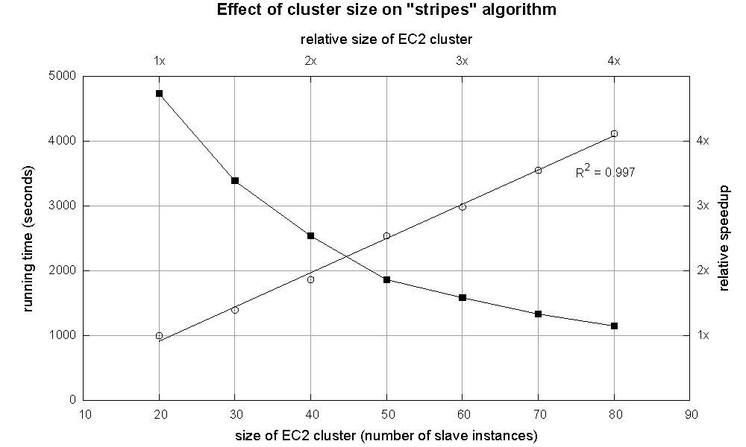

Slide 44
Stripes >> Pairs?
Important tradeoffs
Developer code vs. framework
CPU vs. RAM vs. disk vs. network
Number of key-value pairs: sorting and shuffling data across the network
Size and complexity of each key-value pair: de/serialization overhead
Cache locality and the cost of manipulating data structures
Additional issues
Opportunities for local aggregation (combining)
Load imbalance

Slide 45
Tradeoffs
Pairs:
Generates a lot more key-value pairs
Less combining opportunities
More sorting and shuffling
Simple aggregation at reduce
Stripes:
Generates fewer key-value pairs
More opportunities for combining
Less sorting and shuffling
More complex (slower) aggregation at reduce

Slide 46
Relative Frequencies
How do we estimate relative frequencies from counts?
Why do we want to do this?
How do we do this with MapReduce?

Slide 47
f(B|A): “Stripes”
a → {b₁:3, b₂ :12, b₃ :7, b₄ :1, … }
Easy!
One pass to compute (a, *)
Another pass to directly compute f(B|A)

Slide 48
f(B|A): “Pairs”
What’s the issue?
Computing relative frequencies requires marginal counts
But the marginal cannot be computed until you see all counts
Buffering is a bad idea!
Solution:
What if we could get the marginal count to arrive at the reducer first?

Slide 49
f(B|A): “Pairs”
(a, *) → 32
Reducer holds this value in memory
(a, b₁) → 3
(a, b₂) → 12
(a, b₃) → 7
(a, b₄) → 1
…
(a, b₁) → 3 / 32
(a, b₂) → 12 / 32
(a, b₃) → 7 / 32
(a, b₄) → 1 / 32
…
For this to work:
Emit extra (a, *) for every b_{n} in mapper
Make sure all a’s get sent to same reducer (use partitioner)
Make sure (a, *) comes first (define sort order)
Hold state in reducer across different key-value pairs

Slide 50
“Order Inversion”
Common design pattern:
Take advantage of sorted key order at reducer to sequence computations
Get the marginal counts to arrive at the reducer before the joint counts
Additional optimization
Apply in-memory combining pattern to accumulate marginal counts

Slide 51
Synchronization: Pairs vs. Stripes
Approach 1: turn synchronization into an ordering problem
Sort keys into correct order of computation
Partition key space so each reducer receives appropriate set of partial results
Hold state in reducer across multiple key-value pairs to perform computation
Illustrated by the “pairs” approach
Approach 2: data structures that bring partial results together
Each reducer receives all the data it needs to complete the computation
Illustrated by the “stripes” approach

Slide 52
Secondary Sorting
MapReduce sorts input to reducers by key
Values may be arbitrarily ordered
What if we want to sort value also?
E.g., k → (v₁, r), (v₃, r), (v₄, r), (v₈, r)…

Slide 53
Secondary Sorting: Solutions
Solution 1
Buffer values in memory, then sort
Why is this a bad idea?
Solution 2
“Value-to-key conversion” : form composite intermediate key, (k, v₁)
Let the execution framework do the sorting
Preserve state across multiple key-value pairs to handle processing
Anything else we need to do?

Slide 54
Recap: Tools for Synchronization
Preserving state in mappers and reducers
Capture dependencies across multiple keys and values
Cleverly-constructed data structures
Bring partial results together
Define custom sort order of intermediate keys
Control order in which reducers process keys

Slide 55
Issues and Tradeoffs
Important tradeoffs
Developer code vs. framework
CPU vs. RAM vs. disk vs. network
Number of key-value pairs: sorting and shuffling data across the network
Size and complexity of each key-value pair: de/serialization overhead
Cache locality and the cost of manipulating data structures
Additional issues
Opportunities for local aggregation (combining)
Local imbalance

Slide 56
Debugging at Scale
Works on small datasets, won’t scale… why?
Memory management issues (buffering and object creation)
Too much intermediate data
Mangled input records
Real-world data is messy!
There’s no such thing as “consistent data”
Watch out for corner cases
Isolate unexpected behavior, bring local

Slide 57
Source: Wikipedia (Japanese rock garden)

